Slide 1
Placement in VLSI Physical Design-1

Slide 2
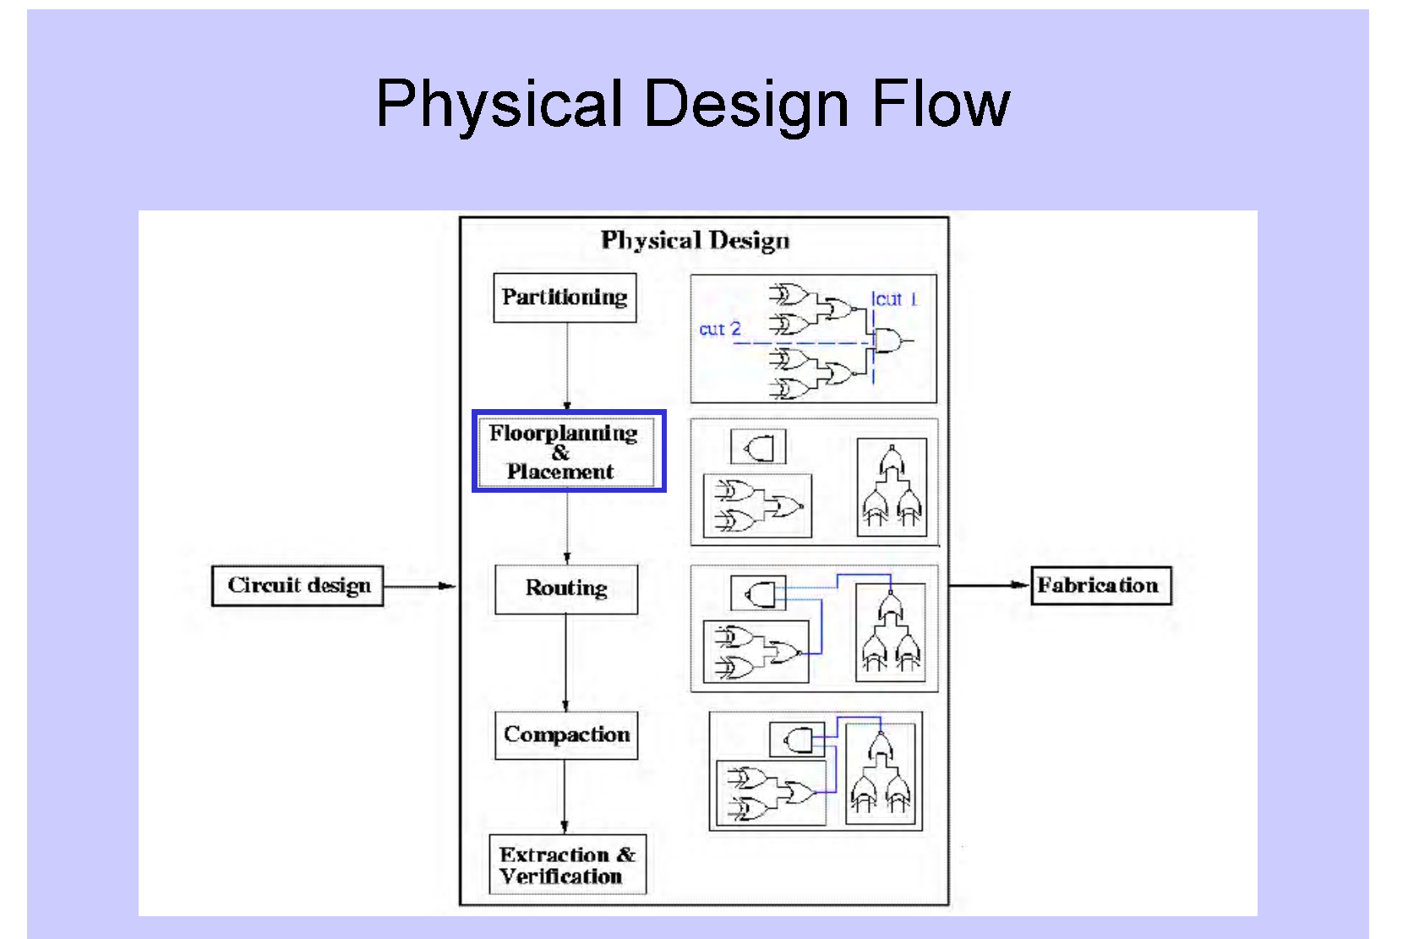

Slide 3
VLSI Placement – A Combinatorial Problem
A
B
C
D
E
F
G
H
A set of blocks/cells
2
2
3
D
F
3
1
4
B
1
4
A
5
8
G
8
5
H
7
C
7
6
E
9
6
9
A floorplan
A placement on the floor
Number of different placements for 1000 cells in a 1000-room floor is 1000! (approximately 10²⁵⁶²)

Slide 4
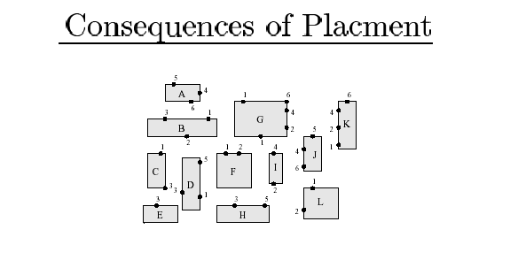
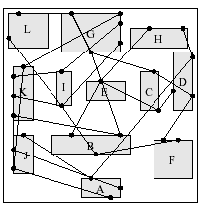
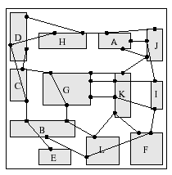
terminals of net 2
Fixed-size blocks to be placed
A bad placement
A good placement

Slide 5
Importance of Placement
Placement is a fundamental problem for physical design
Glue of the physical synthesis
Very important as it:
  Directly defines the interconnects
  Many approaches to handle timing, routability, etc.
Reasons:
  Serious interconnect issues (delay, routability, noise) in deep-submicron design
    Placement determines interconnect to the first order
    Need placement information even in early design stages (e.g., logic synthesis)
  Placement problem becomes significantly larger

Slide 6
Cost Function: Wire length
Since final routing is not yet available, the exact wirelength cannot be calculated
For each net, find the minimum rectangle which includes the net, and the half of its perimeter is the estimated length of the net
The total estimated length, L =∑ p_{i}/2 for i= 1 to N (number of nets)

Slide 7
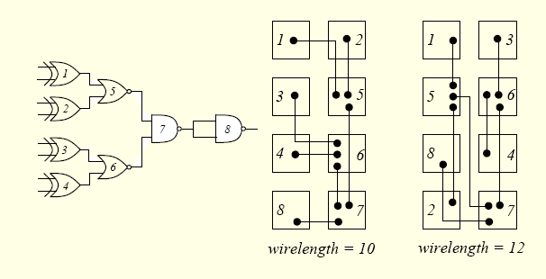
Different Wire Lengths

Slide 8
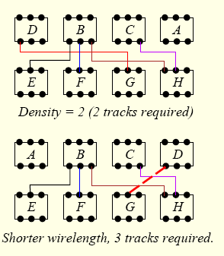
Different Routability/Chip Area

Slide 9
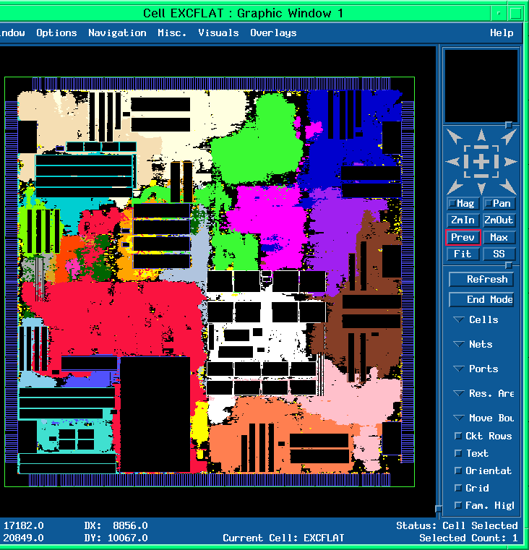
Placement Examples -I
Unconstrained
Placement

Slide 10
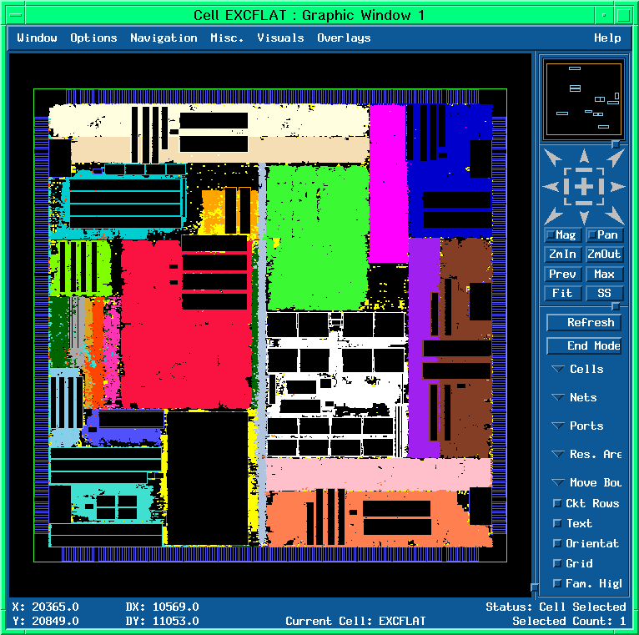
Placement Examples - II
Floorplanned
Placement

Slide 11
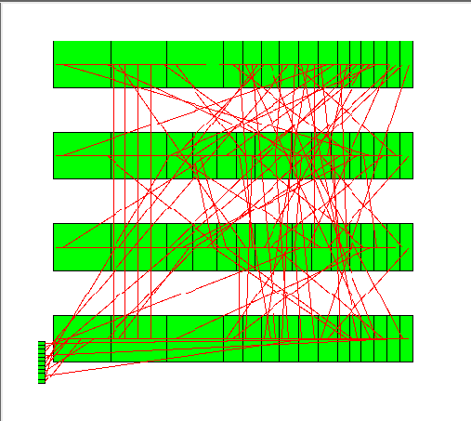
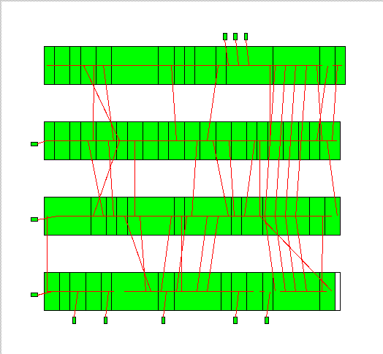
Placement: Good and Bad Examples
bad placement
good placement

Slide 12
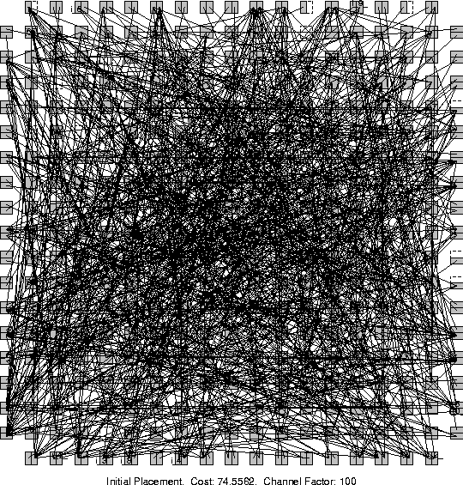
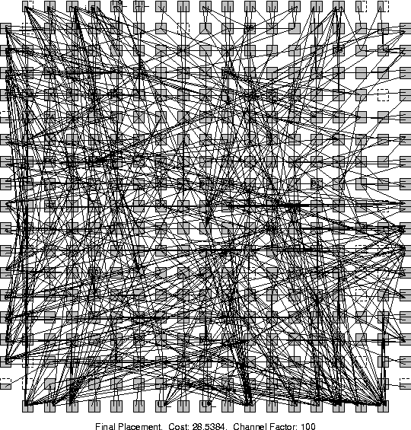
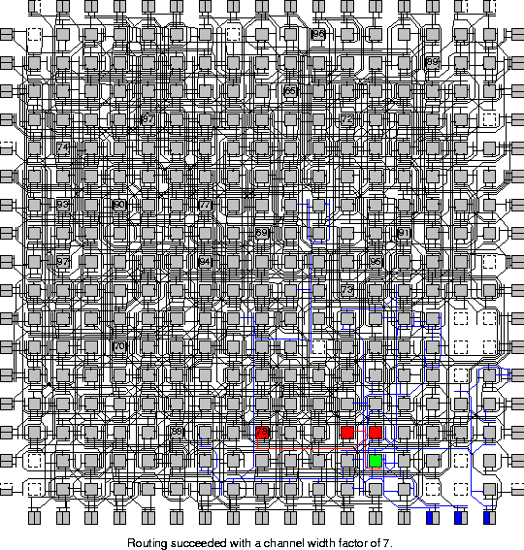
Placement can Make a Difference
MCNC Benchmark circuit e64 placed on FPGA
Random Initial
Placement
Final
Placement
After Detailed
Routing

Slide 13
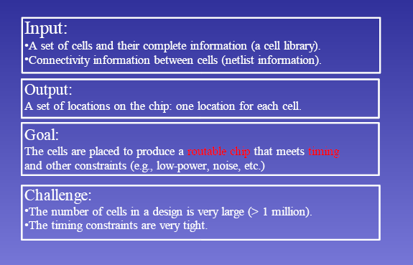
Placement Problem

Slide 14
Defining Placement Problem
Problem
  Given a netlist, and fixed-shape cells (small, standard cell), find the exact location of the cells to minimize area and wire-length
  Modules:
    Usually fixed, equal height
    Some fixed (I/O pads)
    Connected by edges or hyperedges
Objectives
  Cost components: area, wire length
    Additional cost components: timing, congestion, etc.
Notes:
- Note that the green module in the floorplan shown in the mid-right does not fill its “placeholder”

Slide 15
Placement Problem Formulation
Input:
  Blocks (standard cells and macros) B1, ... , Bn
  Shapes and Pin Positions for each block Bi
  Nets N1, ... , Nm
Output:
  Coordinates (x_{i} , y_{i} ) for block Bi.
  No overlaps between blocks
  The total wire length is minimized
  The area of the resulting block is minimized or within a given
  fixed die
Other considerations: timing, routability, clock, buffering and interaction with physical synthesis

Slide 16
Basic two cost components
Wire length based cost function L
Cut-based cost function K
For K, take a vertical or horizontal cut line and determine the number of nets crossing the cut line
Two cost functions can be combined with a scaling factor λ
cost= λK + (1- λ)L

Slide 17
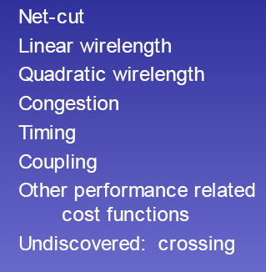
Cost Functions for Placement

Slide 18
Placement Cost Components
Area
  Would like to pack all the modules very tightly
Wire length (half-perimeter of the net bounding box)
  Minimize the average wire length
  Would result in tight packing of the modules with high connectivity
Overlap
  Could be prohibited by the moves, or used as penalty
  Keep the cells from overlapping (moves cells apart)
Timing
  Not a 1-1 correspondent with wire length minimization, but consistent on the average
Congestion
  Measure of routability
  Would like to move the cells apart

Slide 19
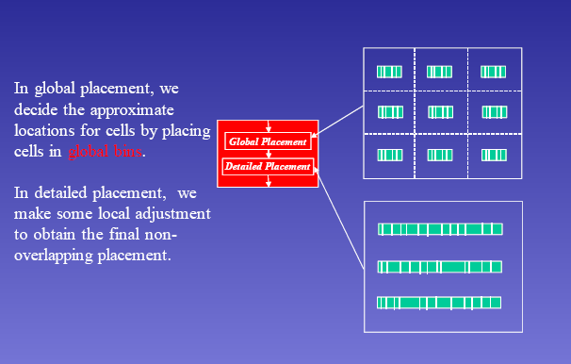
Global and Detailed Placement
Notes:
- Note that the green module in the floorplan shown in the mid-right does not fill its “placeholder”

Slide 20
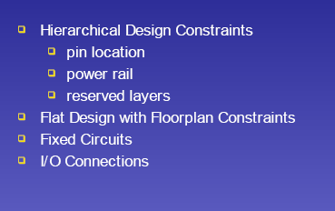
User Constraints/Design Styles
Notes:
- Note that the green module in the floorplan shown in the mid-right does not fill its “placeholder”

Slide 21
Simple Placement Algorithm
1. Start with an arbitrary placement
2. Make an exchange if it results a cost decrease or a small cost increase (if cost decrease is not possible)
3. Repeat step 2
This algorithm works well, if number of modules is small (say, 15)
For larger problems, more sophisticated techniques are required
Notes:
In the top down placement, should we assign 1 to A or to B? What should be the balance criteria? 50-50? 30-70? How many cuts should we make at each level? Bipartitioning? Quadrisection?

Slide 22
Placement Algorithms
Top-Down
  Partitioning-based placement
  Recursive bi-partitioning or quadrisection
    Cut direction?
    Partition vs. physical location
Iterative
  Simulated annealing
  or: Force directed
  Start with an initial placement, iteratively improve the wire-length and area
Constructive
  Start with a few cells in the center, and place highly connected adjacent modules around them
A
2
1
B
C
L
H
D
B
A
F
G
Notes:
In the top down placement, should we assign 1 to A or to B? What should be the balance criteria? 50-50? 30-70? How many cuts should we make at each level? Bipartitioning? Quadrisection?

Slide 23
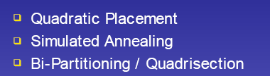

Traditional Placement Algorithms
Notes:
- Note that the green module in the floorplan shown in the mid-right does not fill its “placeholder”

Slide 24
Force-Directed Placement: Features
explores similarity between placement problem and classical mechanics problem of a system of bodies attached to springs
blocks connected by nets are assumed to exert mutual attractive forces
magnitude of the force α distance between the two blocks
magnitude of the force α weighted sum of nets between the two blocks
if the blocks are allowed to move freely, they would move freely until equilibrium state is reached
final equilibrium configuration of placement of blocks
force considered in either horizontal or vertical directions
Notes:
If the “springs” are the only forces in effect, all the cells would collapse to one point

Slide 25
Force-Directed Placement
Model
  Wires simulated as springs
  (if the only force is due to the springs, what will happen?)
  Force_{ij} = Weight_{ij} x distance_{ij}
  Cell sizes as repellant forces
  “vacant” regions work as “attracting” forces
  “overcrowded” regions work as “repelling” forces
Algorithm
  Solve a set of linear equations to find an intermediate solution (module/block locations)
  Repeat the process until equilibrium
Notes:
If the “springs” are the only forces in effect, all the cells would collapse to one point

Slide 26
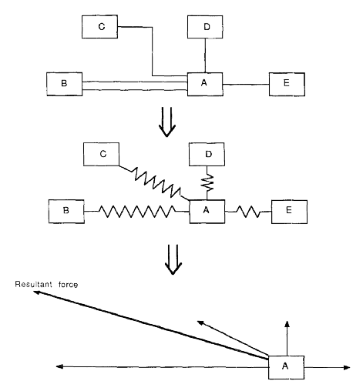
An Example
Resultant
Force

Slide 27
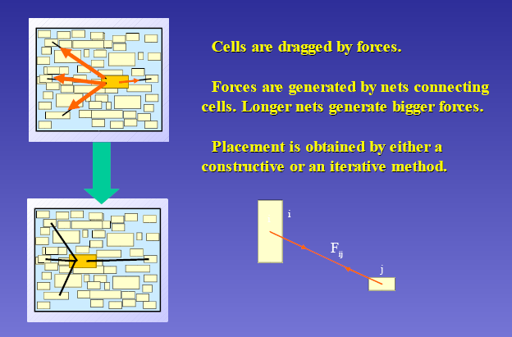
Force Directed Placement (Contd.)

Slide 28
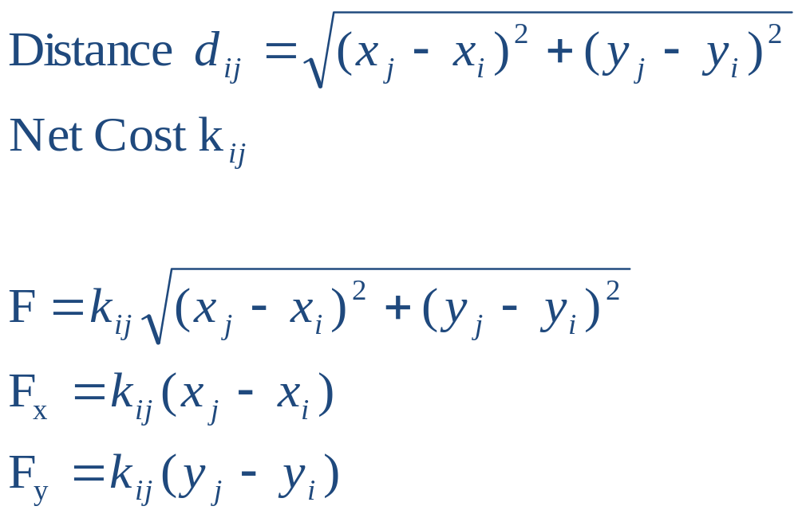
Force Calculation
Hooke’s Law:
  Force = Spring Constant x Distance
Can consider forces in x- and y-direction separately:
(x_{j}, y_{j})
F
F_{x}
(x_{i}, y_{i})
F_{y}

Slide 29
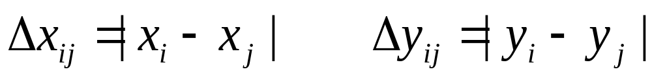
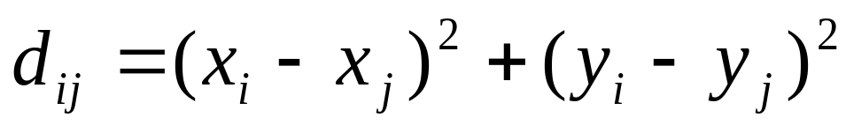
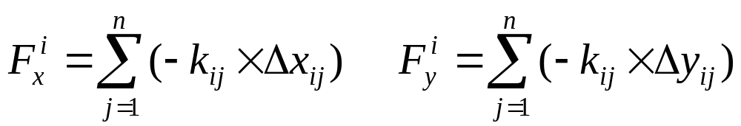
Force-Directed Placement (Contd.)
Model (details):
  Cell distances: either
  OR:
  Forces:
  Objective: find x,y coordinates for all cells such that total force exerted on each cell is zero.

Slide 30
Constructive Force-Directed Algorithm
First, an initial placement is constructed by placing the modules so that they are in equilibrium with respect to the forces acting on them.
That is, for any module M_{j}, Σ_{j} k_{ij} (x_{j} - x_{i}) = 0 and Σ_{j} k_{ij} (y_{j} - y_{i}) = 0 for all module M_{i}.
However, trivial solution: x_{j} = x_{i} for all i, j. Everything placed on the same position!
Need to have some way to avoid overlapping.
Several possible ways to avoid overlapping:
  Add some repulsive force which is inversely proportional to distance (or distance squared).
  Have connections to fixed I/O pins on the boundary of the placement region.
  Not really move to the equilibrium position, but a nearby position without introducing overlapping.

Slide 31
Iterative Force-Directed Algorithm
Start with an initial position of Modules
The Module M with maximum force acting on it is identified
Place M at its ideal position (x,y), where no force is acting on it
If it causes overlap with another module M’
– Move M’ to where M was previously placed, or
- the resulting overlap may be tackled at later stage
The above process is repeated for all badly placed modules
Each module can be displaced a constant number of times

Slide 32
Iterative Force-Directed Algorithm: Another approach
Start with an initial position of Modules
For every pair of modules, calculate the resulting total force if they are exchanged.
Select the pair with best total force, switch them and lock
The step is repeated until all are locked
The best intermediate solution is the best placement

Slide 33
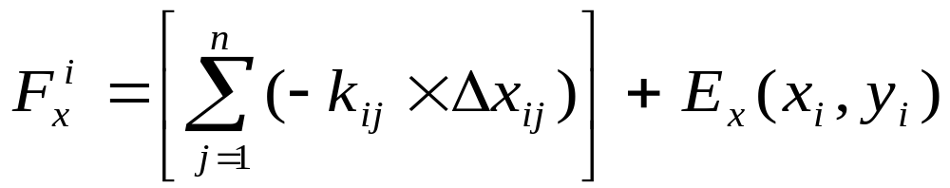
Force-Directed Placement (Contd.)
Avoiding overlaps or collapsing in one point?
  Use fixed boundary I/O cells (pre-assigned positions)
  Use repelling force between cells that are not connected by a net
  Do not allow a move that results in overlap
  Use repelling “field” forces from congested areas to sparse ones
Problems with force directed:
  Overlap still might occur
  Flat design, not hierarchy
Iterative method preferred

Slide 34
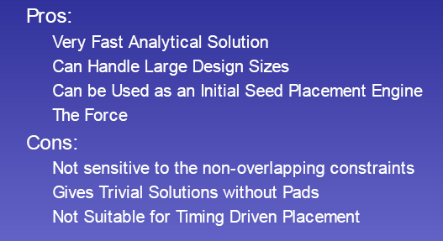
Force Directed Placement: Pros and Cons

